Slide 1
Mechanics
Mack 2023

Slide 2
Learning Objectives
Mechanics are one of the tools that designers use to create meaningful decisions (depth) and rich gameplay.
Deep gameplay sustains player interest over long time periods and allows players to gain mastery.

Slide 3
New “Robot” Mechanic
Design a new action for their robot.
An example mechanic could be: Move forward 2 spaces, then deal 1 damage to each surrounding space.
Give their custom action a name.

Slide 4
Mechanics
We have just designed a mechanic for a content piece.
Game designers are regularly tasked with designing mechanics for content pieces. For example, a game designer might design a weapon’s mechanics or a boss’ abilities (not unlike what we have just done).
In Us vs It, the designer would be able to alter the mechanics of the game board size, whether there are obstacles, how turns work, the tanks and their movesets, how the robot’s turn functions, etc.)

Slide 5
Mechanics
We have just designed a mechanic for a content piece.
Game designers are regularly tasked with designing mechanics for content pieces.
For example, a game designer might design a weapon’s mechanics or a boss’ abilities (not unlike what we have just done).
In Us vs It, the designer would be able to alter the mechanics of the game board size, whether there are obstacles, how turns work, the tanks and their movesets, how the robot’s turn functions, etc.)

Slide 6
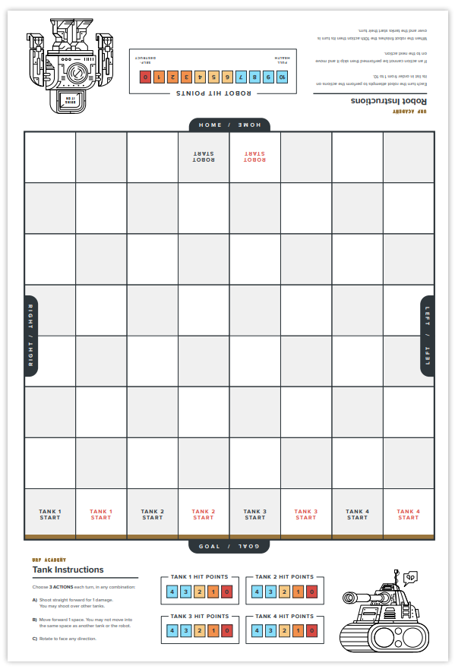
Robots Fight
You will be be joining another group in this lesson
Setup two teams of tanks and robots on the game board as shown on the side!

Slide 7
Game Rules
The objective of the game is for one tank team to destroy the other team’s robot first.
Students make a decision on two of the rules in the game on a group by group basis.

Slide 8
CHOOSE EITHER:
Tanks on opposing teams can destroy each other.
Tanks on opposing teams cannot destroy each other.

Slide 9
CHOOSE EITHER:
Robots on opposing teams cannot damage each other.
Robots on opposing teams can damage each other.

Slide 10
Rule
Robots deal damage to tanks regardless of their team.

Slide 11
Core Game Loop
Follow the core game loop from the previous lesson.
Team 1’s tanks take their turns.
Team 2’s tanks take their turns.
Team 1’s robot executes its action order.
Team 2’s robot executes its action order
Repeat until one team reigns victorious.

Slide 12
Depth
The ability for a player’s decisions to result in meaningfully different outcomes. It’s often referred to as the “meaningful decisions” that players make in a game.
These meaningfully different outcomes force players to make meaningful decisions.
For example, if a player chooses to position themselves to the left of another player instead of the right they’re making a meaningful decision that would impact the way they play and the outcome of the game. But standing a step back from the other player is less so.

Slide 13
Depth
When a game is balanced, it is more likely for deep choices to emerge. When a game is not balanced, depth is lost because some choices will just be strictly superior to others and result in more deterministic outcomes in gameplay.
In the first Us vs It play through, it is likely that regardless of what the tank players did, the robot won anyway (probably by moving through the goal), or the tank players won without thinking about anything because the robot kept running into the wall. This is an example of an imbalanced game being unable to expose its depth to the player.

Slide 14
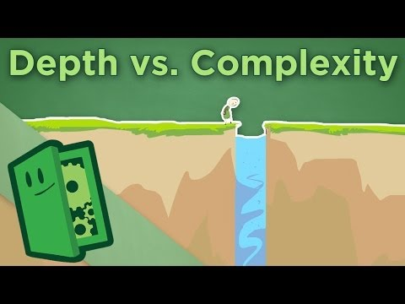
Depth & Complexity

Slide 15
Breath
The number of decisions that a player can make at a given time.
Breadth is one of the causes of analysis paralysis (paralysis from too many choices).
Generally speaking, 2-5 choices is a good amount to avoid this.

Slide 16
Complexity
Complexity is the amount of information a player needs to know in order to make a decision. It can be thought of as the number of sentences it would take to explain how to play the game or take an action (I.e., how complicated it is).
Complexity is the other cause of analysis paralysis; when a game has too much complexity, players can be paralyzed while trying to make a decision.
Designers can add depth to a game by adding more and more options, but this is usually infeasible due to the high complexity cost associated with doing this.

Slide 17
Rock Paper Scissors
Consider Rock, Paper, Scissors.
This is a game that is not very deep.
Adding two more options will increase depth, but also drastically increase complexity (the player now needs to remember which of the 5 options defeats the other 4 options [there are now 10 combinations to memorize, as opposed to 3]).

Slide 18
Elegance
The ratio of depth to complexity. The higher the depth and the lower the complexity, the more elegant the design.
Clever designers will hide complexity until it is immediately relevant (E.g., well constructed and segmented rule books for board games or designing the game so that you only need to know a smaller subset of information to start the game).
Designers should try to aim for elegance (high depth, low complexity) as it results in the best gameplay, while still being learnable. This is especially true when designing a game’s systems.
The worst case scenario for a game (or a mechanic) is to be very complex with low depth as this creates a high barrier to entry for players, while being a relatively unsatisfactory and potentially boring experience.

Slide 19
Improve a Game
Pick either Us vs It, Your Us vs It themed game or Goals Game to make meaningful improvements to any of the axes that we have currently learned.

Slide 20
Set Goals
Start with a goal for the iterations
Clearly stating a goal provides a guiding light for what the students are ultimately trying to achieve and a core value to fall back to in case they get stuck. Having a goal such as “improve the game” is likely to produce worse results than a goal which explicitly states what we’re trying to improve. These could include tactics such as:

Slide 21
US VS IT
The 3 abilities of the tanks in Us vs It could be changed to improve depth.
The abilities of the robot could be changed to improve depth.
The entire game flow and operations could be changed to decrease repetitiveness.
The game could pit the 4 players against each other with the robot as a rogue unit that attempts to kill the tanks.

Slide 22
GOALS GAME
Adjust the goals game to include secret goals and the ruleset surrounding them.
What if there are two goals in play at once?
What if exactly one player is assigned a secret goal?
The entire baseline game could be changed to not use paper footballs.
E.g., A game where you flick coins onto colored pieces of paper and score points based on the color it landed on.

Slide 23
Opposition and Interaction
Tailor any of the existing game mechanics to promote depth in gameplay.
We previously discussed how some of the goals cards produced interesting decisions for other players.
Improvements could focus on creating cards that have the maximum depth or to adjust the baseline game (without cards) to have maximum depth.

Slide 24
Thematic and Narrative
Retheme the Goals Game to include a theme and a narrative

Slide 25
Present Changes!
Students take turns to present and defend their design decisions.
3 Minute timebox for each group!

